Slide 1


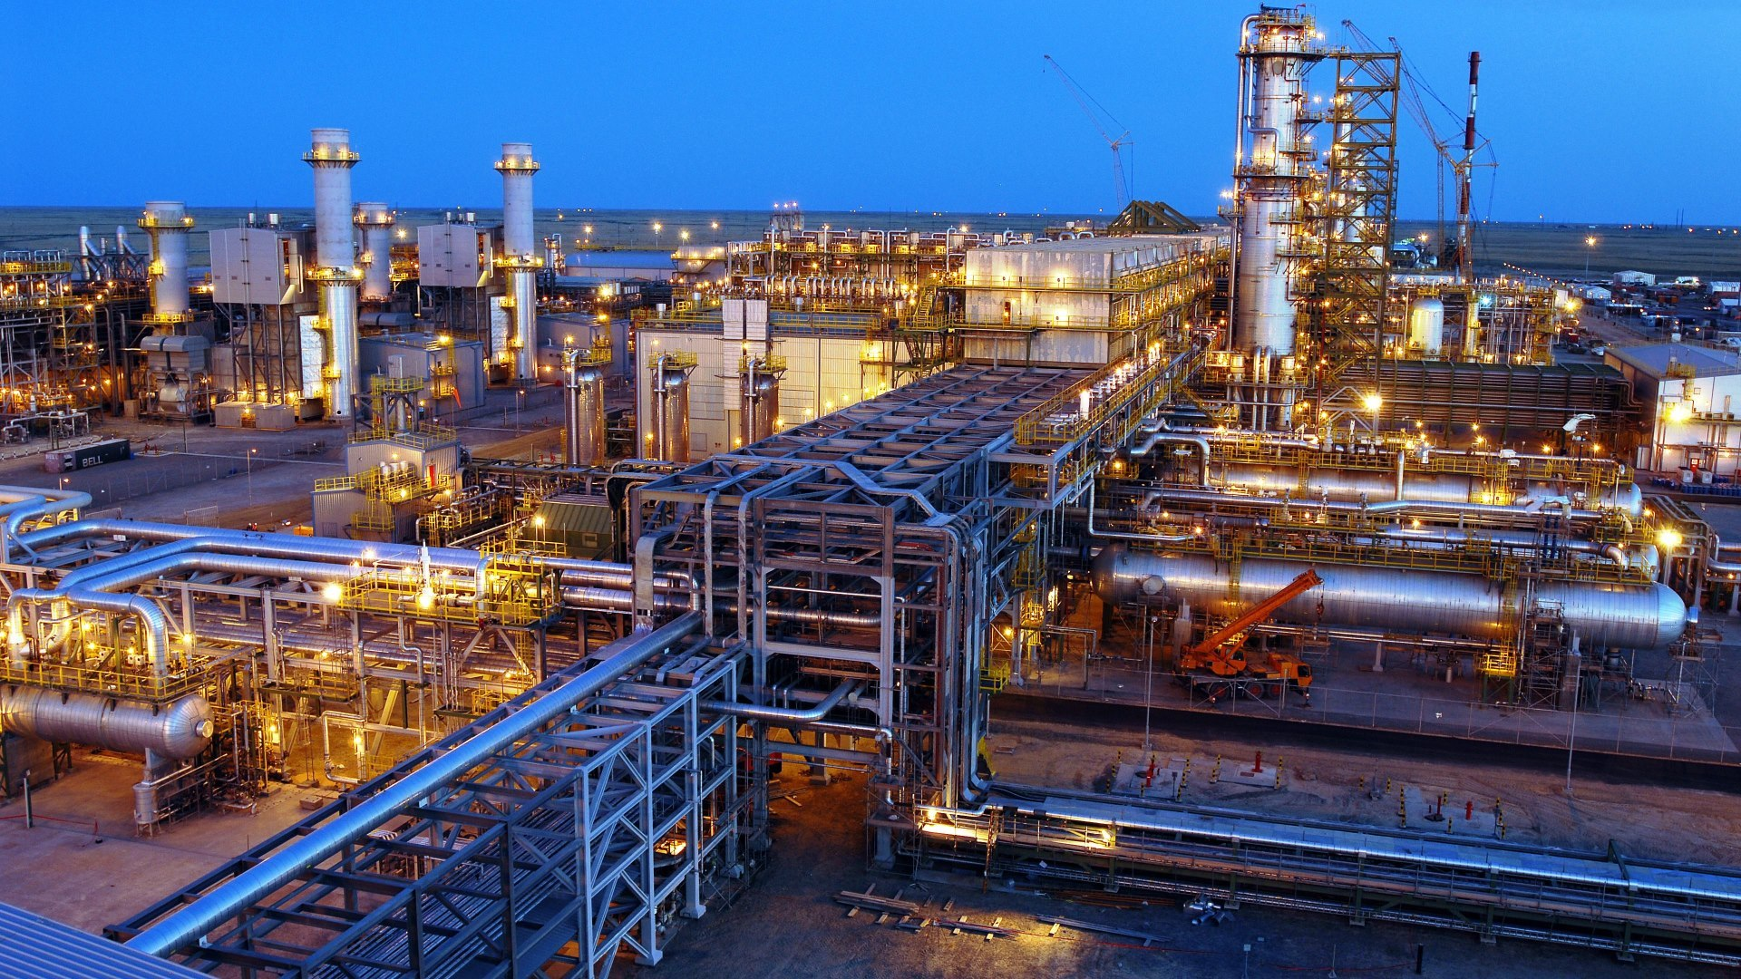
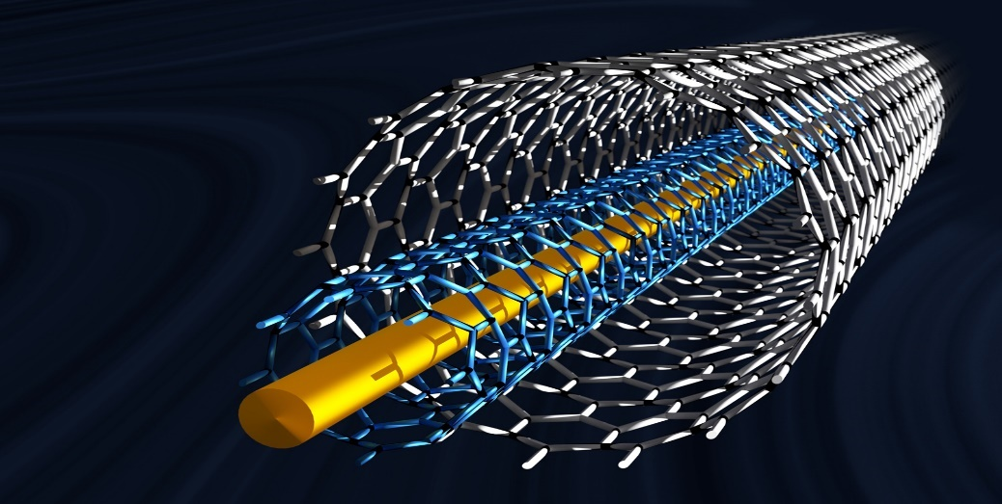

MARKET INTELLIGENCE | CONSULTING
www.techsciresearch.com
Market Survey for Specialty Products
Final Presentation
Prepared for:

Slide 2

Final Findings
Product Name | Demand Supply Gap -2025 | Demand Supply Gap -2040 | Export Potential | Backward Integration | Forward Integration | Recommendations
Carbon Dioxide | High | High | Yes | Yes | Yes | Project can be planned immediately
White Oil | Medium | High | Yes | Yes | No | Project can be planned immediately
Dicyclopentadiene | High | High | Yes | No | Yes | Project can be planned immediately
Isoparaffin | Medium | High | Yes | No | No | Project can be planned immediately
Multiwalled Carbon Nanotubes | Medium | High | Yes | No | No | Project can be planned immediately
High Temperature Molten Salts | Medium | High | Yes | No | No | Project can be planned immediately
Warm Mix Asphalt Additives | Medium | High | Yes | No | No | By FY 2025-26
Jp-10 | Nil | Potential Demand Only depending on the product availability and pricing | Yes | Yes | No | By FY 2025-26

Slide 3

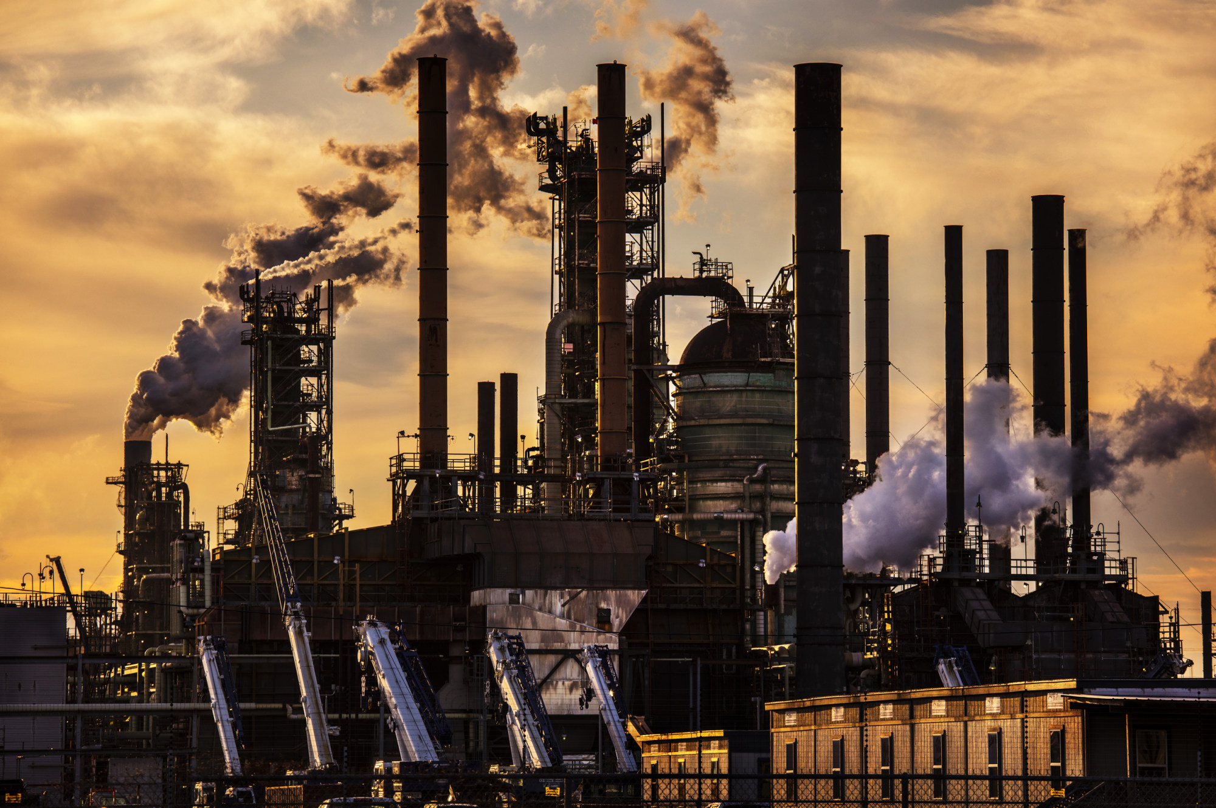


2015 – 2040
INDIA CARBON DIOXIDE MARKET
FORECAST & OPPORTUNITIES
Prepared for :
MARKET INTELLIGENCE . CONSULTING
www.techsciresearch.com

Slide 4
Key Insights : India Carbon Dioxide Market
India Merchant Carbon Dioxide Demand, By Volume, FY2015, FY2021, FY2022E and FY2040F (Thousand Tonnes)
India Carbon Dioxide Market Share, By Region , By Volume, FY2021
Demand Drivers – Gas, Liquid & Solid Form
Expansion of food & beverages industry
Strong growth in Oil & Gas Exploration through Enhanced Oil Recovery
Increasing chemical processing capacity of the nation
Strong focus on treatment of effluent discharge to control water pollution
Increasing attempts to control fire accidents in industrial sector
Majority of the carbon dioxide recovery plants in India are installed in association with either fertilizer plants and distilleries. By 2040, India has potential to consume 24 million tonnes (MT) of carbon dioxide.
The fertilizer industry and oil and gas exploration will be the largest consumer of carbon dioxide. Other commercial applications are food and beverage production, metal fabrication, cooling, fire suppression, etc.
The substantial demand growth in domestic end-user industry till 2040 have a potential of setting up a domestic carbon dioxide unit of around 2000 thousand tons.
HPCL is advised to invest in the carbon dioxide manufacturing.

Slide 5
Recommendations for HPCL Research & Development Team
The utilization of carbon dioxide as a feedstock for producing a wide variety of fuels/chemicals is expected to provide new opportunities to various process industries across the globe.
Large Scale CCS Facility by Facility Status (As of Dec 2020)
1
Various technology pathways are being explored globally & technology providers are working extensively to produce cost-effective chemicals. Extensive research & development work is being carried out by technology providers to produce effective catalysts (required for CO2 conversion).
2
CO2 Capture Technologies
Post-combustion
Pre-combustion
Oxy-fuel-combustion
3
Several technologies to produce fuels or chemicals by catalytic, electrochemical, mineralization, copolymerization, etc., are currently being explored by technology providers globally.
In the present scenario, the CO2 based chemicals that appear to be viable at the high level of maturity, as well as suitable for implementation in near future include methanol, polycarbonate, carbon monoxide, methane & calcium carbonates.
4
There has been a significant progresses through which gaseous carbon dioxide can be converted to valuable products. It is advised to use the gas for captive as there has been development of significant technologies which will convert carbon emissions from large point sources such as industrial facilities and power plants into valuable products such as alternative fuels, building materials and many more

Slide 6
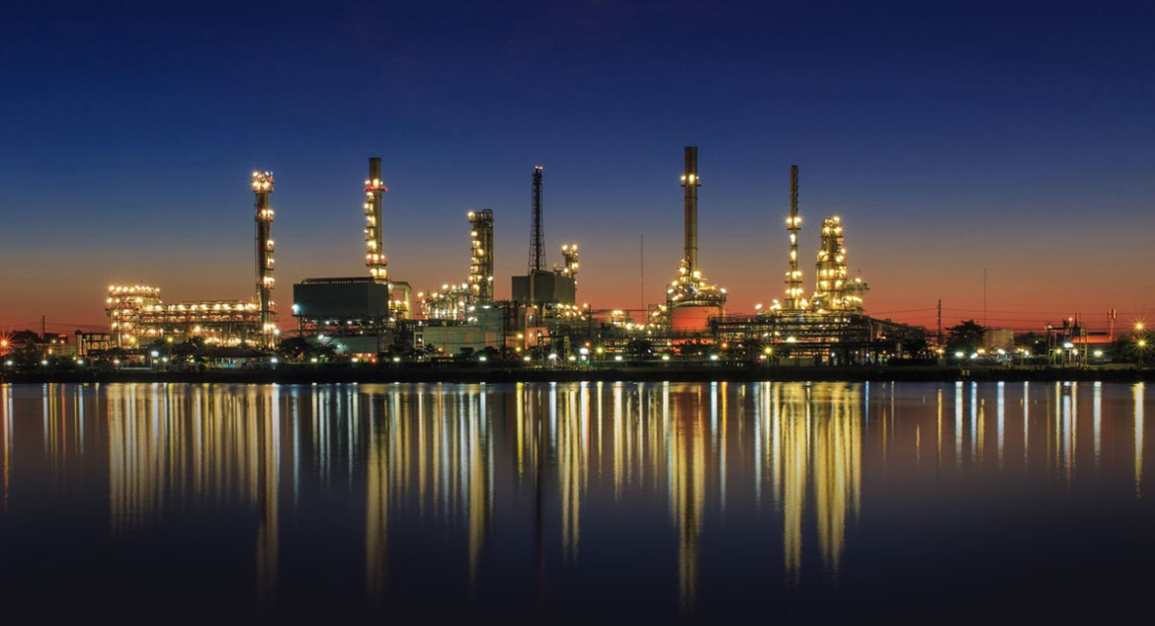
2015 – 2040F
INDIA WHITE OILS MARKET
FORECAST & OPPORTUNITIES
Prepared for :
MARKET INTELLIGENCE . CONSULTING
www.techsciresearch.com

Slide 7


Key Insights : India White Oils Market
India White Oils Demand, By Volume, FY2015, FY2021, FY2022E and FY2040F (Million Litres)
India White Oils Market Share, By Region , By Volume, FY2021
Current capacity of Specialty oils blending in India is around 1980 million litres. The rising demand for personal care products in the country has aided cosmetic formulators in their efforts to innovate and produce new products. White oil's lubricity, moisture barrier properties, and chemical inertness make it ideal for use in cosmetics and personal care products.
It is recommended that HPCL should enter base oil and white oil manufacturing to cater domestic and export market as current domestic capacity of the base oil is not sufficient to cater domestic supply and have scope for significant amount to export.
The substantial demand growth in domestic end-user industry till 2040 has a potential of setting up a domestic white oil blending unit of around 500 thousand tonnes.
HPCL has a huge potential of finished white oil export due to growing demand in end user application from overseas market.
Due to low cost of blending, companies in India have substantial market potential and edge over profit margin to its foreign competitors while exporting White oils.
India White Oils Market Share, By End User Industry, By Value, FY2021

Slide 8
Go-to-Market (GTM) Strategy
Scenario 1-Base Oil Import
The import prices of base oil are volatile, depending on the crude oil prices. If HPCL imports base oil for the manufacturing of white oil, the profit margin will shrink and the domestic competition with other established players in the market will push the market to a highly competitive market.
Scenario 2-Base Oil Manufacturing
HPCL should focus on producing base oil at its refinery which will give HPCL an upper edge with other domestic players in the White Oil market. Further, HPCL will be able to add higher profit margin and the company can trade base oil with other white oil manufacturers which will help the company to expand its product portfolio.
Export Potential
HPCL has a huge export potential of white oil, especially IP grade of white oil. Majority of overseas end use consumer prefer IP grade over technical grade. South America & North America are high potential market.
Domestic Market
HPCL should focus on strategic tie-ups with FMCG and Cosmetic manufacturers in India, which will help the company in selling bulk quantities of white oil. Further, HPCL can customize white oil as per the clients’ requirement.

Slide 9
Recommendations for HPCL
The market of white oil manufacturers is dominated by private players while base oil manufacturers mainly OMCs have vertically integrated their Lubricating Oil Base Stock (LOBS) unit to produce specialty oils including transformer and white oils. Currently, only BPCL and IOCL have the facility to produce base oil. These Oil Marketing Companies further process White Oil from Base oil according to the demand from their B2B customers. However, these companies do not have the limitation to market base oil directly to white oil manufacturers due to cost and specification limitation. White oil manufacturers in the country import Base oil from foreign companies. HPCL has a similar value chain structure as of IOCL and BPCL. Likewise, HPCL has the potential and advantage over other White oil manufacturers by having an in-house specialty base oil manufacturing. HPCL will be able to match the specification and price parity with foreign base oil manufacturer. The company will have an edge to market Base oil to these large number of white oil manufacturers in the country.
Suggested Product Mix Capacity
Group II Base Oil | Suggested Annual Capacity (KTPA) | Location
70N | 50 | Mumbai Refinery
150N | 50 | Mumbai Refinery
500 N | 100 | Mumbai Refinery
Group III Base Oil | 50 | Mumbai Refinery
Specialty Oil | Suggested Annual Capacity (KTPA) | Location
White Oil | 40 (Domestic + Export Potential) | Mumbai Refinery
Transformer Oil | 80 ( Domestic Market Potential) | Mumbai Refinery

Slide 10
Recommendations for HPCL Research & Development Team
White Oil & Speciality Oil Production Value Chain (except BPCL)
Conning application, Quenching, Stainless Steel Wire, Thermoplastic & elastomer, etc.
(Application)
Imported Base Oil
Domestic Lube Blenders
(Major Specialty & White Oil Supplier)
(Major Base Oil Supplier)
Specialty Oil
(Major White Oil Importer)
Savita Oil, Columbia Petro Chem, Gandhar Oil, Apar Industries,Panama Petrochem
(Process)
S-Oil, GS Caltex Kixx Lubo
Based on Demand, Product is refined to Specialty oil or White oil
White Oil
Personal Care & Cosmetic, Pharmaceuticals, Food & Biotech Products and others.
Majority of Testing of base oil is
done on port after unloading
Domestic Blenders are only enhancing the properties of base oil
According to end use demand specialty or White oil is produced
(Application)
BPCL White Oil & Speciality Oil Production Value Chain
Conning application, Quenching, Stainless Steel Wire, Thermoplastic & elastomer, etc.
(Application)
Process
The base oil is treated, and filtration & modification is done to meet the specific requirement of white oil. The specific requirement include pour point, flash point, viscosity and density.
Note:- Imported Base Oil sample is sent to lab at the time of unloading.
(Process)
Specialty Oil
Based on Demand, Product is refined to Specialty oil or White oil
Inhouse Base Oil Production
White Oil
Personal Care & Cosmetic, Pharmaceuticals, Food & Biotech Products and others.
(Application)

Slide 11
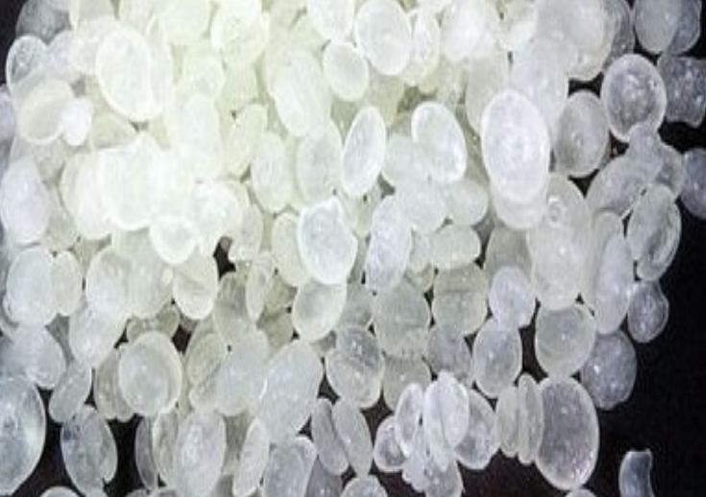
2015 – 2040
2015 – 2040
APAC DICYCLOPENTADIENE MARKET
APAC Dicyclopentadiene MARKET
FORECAST & OPPORTUNITIES
FORECAST & OPPORTUNITIES
Prepared for :
MARKET INTELLIGENCE . CONSULTING
www.techsciresearch.com

Slide 12

Key Insights : APAC Dicyclopentadiene Market
APAC Dicyclopentadiene Demand, By Volume, 2015, 2020, 2021E, and 2040F (Tonnes)
Asia Pacific market of Dicyclopentadiene (DCPD) was valued at USD592.10 million in 2020 which is expected to grow at a CAGR of 8.00% by 2040. With increasing cost of crude oil and rise in production cost the prices of Dicyclopentadiene has increased in the past three years. The cost of production of C5 resins in the refineries have increased by around 2-4% in APAC region.
The demand of Dicyclopentadiene in APAC region is anticipated to reach around 1759 thousand tonnes in 2040 due to increasing demand from the end-user industries and its surging demand for the manufacturing of Unsaturated polyester resins (UPR). China is expected to remain the dominant country in terms of volume for Dicyclopentadiene market.
Currently, in India there is no manufacturer of DCPD is present. Majority of the demand in the country is met through import from China and Brazil. UPR accounts for majority of the market of DCPD Demand followed by Petroleum resin. HPCL has a great opportunity to become the only producer of DCPD in the country.
The burgeoning demand from end use industries of UPR, EPDM, Polydicyclopentadiene, petroleum resin, etc. is anticipated to create an export potential from the country
APAC Dicyclopentadiene Market Share, By Country, By Volume, 2020

Slide 13
Recommendations for HPCL Research & Development Team
Dicyclopentadiene (DCPD) is produced as a by-product of production of ethylene and propylene by a high temperature pyrolysis of petroleum fraction.
Dicyclopentadiene or DCPD is the dimer of cyclopentadiene (CPD) formed by a Diels-Alder addition reaction.
DCPD products originate from high-temperature cracking of petroleum fractions and are best characterized as highly reactive
Intermediates used for a wide range of resins, i.e. aromatic hydrocarbons, unsaturated polyesters, phenolics and epoxies.
CPD, although a stable molecule, has a strong tendency to form the more stable dimer DCPD. This dimerization already takes place at room temperature and its rate rapidly increases with elevated temperatures. This reaction however is reversible too; DCPD “cracks” at temperatures above 140°C to form two CPD molecules
Product Typical Composition
Component | DCPD Resin Grade | DCPD UPR Grade
Endo DCPD | 73-83% | 83-88%
Endo DCPD | 0.5-1% | 0.5-1%
CPD-mCPD Codimer | 7-13% | 2-6%
Isoprene-CPD Codimer | 1-5% | 1-5%
Physical Properties Specification =: Pure Grade
Parameters | Range
Density | 975 - 989 kg/m3 (20 °C / 68 °F)
Dynamic Viscosity | 4 mPas (20 °C / 68 °F)
Vapor Pressure | 186 Pa (20 °C / 68 °F)
Boiling Point | Typical 170 - 190 °C / 338 - 374 °F (1010 hPa)
Melting Point | Typical 33.6 °C
Flash Point | Typical 40 °C (Resin Grade), >25°C (DCPD Grade)
Appearance | Pale straw-coloured liquid

Slide 14
2015 – 2040
INDIA ISOPARAFFIN MARKET
FORECAST & OPPORTUNITIES
Prepared for :
MARKET INTELLIGENCE . CONSULTING
www.TechSciresearch.com

Slide 15

Key Insights : India Isoparaffin Market
India Isoparaffin Demand, By Volume, FY2015, FY2021, FY2022E and FY2040F (Tonnes)
Currently, there is no producers in India due to low demand, higher cost and complexity involved with the process. HPCL has a great opportunity to become the only producer of Isoparaffin in the country.
HPCL have significant scope for Iso-paraffin export to the emerging nations having isoparaffinic solvent application. The company can target emerging countries such as China, Sri Lanka, Oman, Brazil, Middle and African Nations and export Iso-paraffin as a raw material to these industries.
Metal Working Fluid is the leading segment by application coupled with Personal care for Iso-Paraffins. Isoparaffin is widely used for cooling and lubrication fluids in metalworking process.
Low manpower cost and availability of high-end research and complex technological services are growing cosmetic contract manufacturing market in the country. Around 200 companies are operating in cosmetic contract manufacturing and the growing preference for better synthetic solvent as a raw material in these Cosmetic Contract Market will facilitate the growth of Iso- Paraffin demand. Therefore, it is recommended that they should target cosmetic industries for higher growth.
India Isoparaffin Market Share, By Application, By Volume, FY2021
India Isoparaffin Market Share, By Grade, FY2022E (Tonnes)

Slide 16
Recommendations for HPCL Research & Development Team
Isoparaffins, a group of high purity, relatively high boiling synthetic hydrocarbon solvents
Isoparaffinic hydrocarbon is synthesized as a complex mixture of hydrocarbons obtained by alight hydrogenation treatment of a petroleum distillate (naphtha) fraction in the presence of a catalyst.
C9-C11 is the largest importing grade of iso-paraffin in country. C9-C10 based Isoparaffin is dominating the demand of Isoparaffin by grade owing to its wide range of application in various end use industries such as lubricant manufacturing, paints & coatings, etc.
C11-C13 based Isoparaffin are the second largest grade widely used in Industry. Majority of Personal Care manufacturing companies are consuming C11-C13 grade.
It is characterized as an isoparaffinic hydrocarbon because it consists mostly (≈84%) of branched alkanes. Aromatic content is 0.95% maximum.
Characterized by the highest methyl branching level.
Each product contains a low number of isomers, resulting in extremely narrow boiling ranges
Produced using carefully controlled feedstocks and process conditions and naturally low in impurities.
Iso-paraffins demonstrate excellent chemical inertness and stability.
It consists of hydrocarbons having carbon numbers in range C11 to C16
Majorly used Iso-paraffin Grade Specifications
Carbon Range | Distillation Range | Aniline Point (^{O}C) | Flash point (^{O}C)
C9 | 158-174 | 78 | 36
C10-C11 | 185-196 | 81 | 120
C8-C9 | 115-140 | 73 | 4
C10-C11 | 162-177 | 77 | 44
C9-C10 | 185-198 | 15 | 63

Slide 17

2015 – 2040
APAC WARM MIX ASPHALT ADDITIVES MARKET
FORECAST & OPPORTUNITIES
Prepared for :
MARKET INTELLIGENCE . CONSULTING
www.techsciresearch.com

Slide 18




Key Insights : APAC Warm Mix Asphalt Additives Market
APAC Warm Mix Asphalt Additives Market Size, By Volume, 2015, 2020, 2021E, and 2040F (Tonnes)
The demand for Warm Mix Additives is expected to grow exponentially at a CAGR of 14.8% till 2040. Increasing concern for green house gases emission and future projection of sustainable infrastructure will pave the way for the growth of Warm Mix Additives market in India.
WMA technology allows the mixing, transporting and paving process at significantly.
lower temperature compared to the conventional HMA.
India is expected to have significant share in the value market of Warm Mix Asphalt Additives of approximately over 14% by 2040 from 6% in 2021.
HPCL will have the advantage of being the first domestic manufacturer to produce warm mix asphalt mixture.
APAC Warm Mix Asphalt Additives Market Share, By Application, By Volume, 2021E
Increasing Awareness About Reduction In Harmful Emissions
Government Push on Strengthening Road Infrastructure
APAC Warm Mix Asphalt Additives Market Share, By Country, By Volume, 2021E
Less wear and tear on asphalt equipment
Less asphalt aging due to oxidation
Key Influencers

Slide 19
Recommendations for HPCL Research & Development Team
There are three types of Warm Mix Asphalt Additives that can be used for the production of Warm Mix Asphalt Mixtures-
Pavement Length
Moisture Content in the Area
Density of the Mixture
Expected Traffic Density, etc.
Organic Additives being the cost effective choice, Chemical Additives and Foaming Additives are more popular and cover approximately 65% of the market demand. They are cost effective and easy to use and produce.
CATEGORY | COMPOSITION | PRODUCT NAME AVAILABLE
ORGANIC WARM MIX ADDTIVES | Wax Based Composition | SASOBIT
 |  | ASPHALTAN-B
 |  | LICOMONT BS-100
CHEMICAL WARM MIX ADDITIVES | Surfactant Based Composition | EVOTHERM
 |  | REDISET
 |  | CECABASE
FOAMING WARM MIX ADDITIVES | Synthetic Zeolites based Composition | ASPHA MIN
 |  | ADVERA
 |  | WAM Foam
 |  | GENCOR
 | WMA for Surface Course | WMA for Binder Course | WMA for Base Course
Asphalt Content (%) | 5.2 | 4.7 | 4
Air Void (%) | 3.8 | 3.9 | 6.7
Lab-compacted Density (g/cm3 ) | 2.4 | 2.414 | 2.365
RAP Content (%) | 50
Additive Content (%) | 0.8 (by weight of asphalt)
CHEMICAL COMPOSITION | TYPES OF ADDITIVES | FORM
Aliphatic Synthetic Wax produced with the use of the Fischer-Tropsch method | Viscosity Modifier | Granules
Mixture of fatty acid derivatives | Viscosity Modifier | Powder
Organic combined with adhesion promoter | Viscosity Modifier/Adhesion Promoter | Pellets

Slide 20
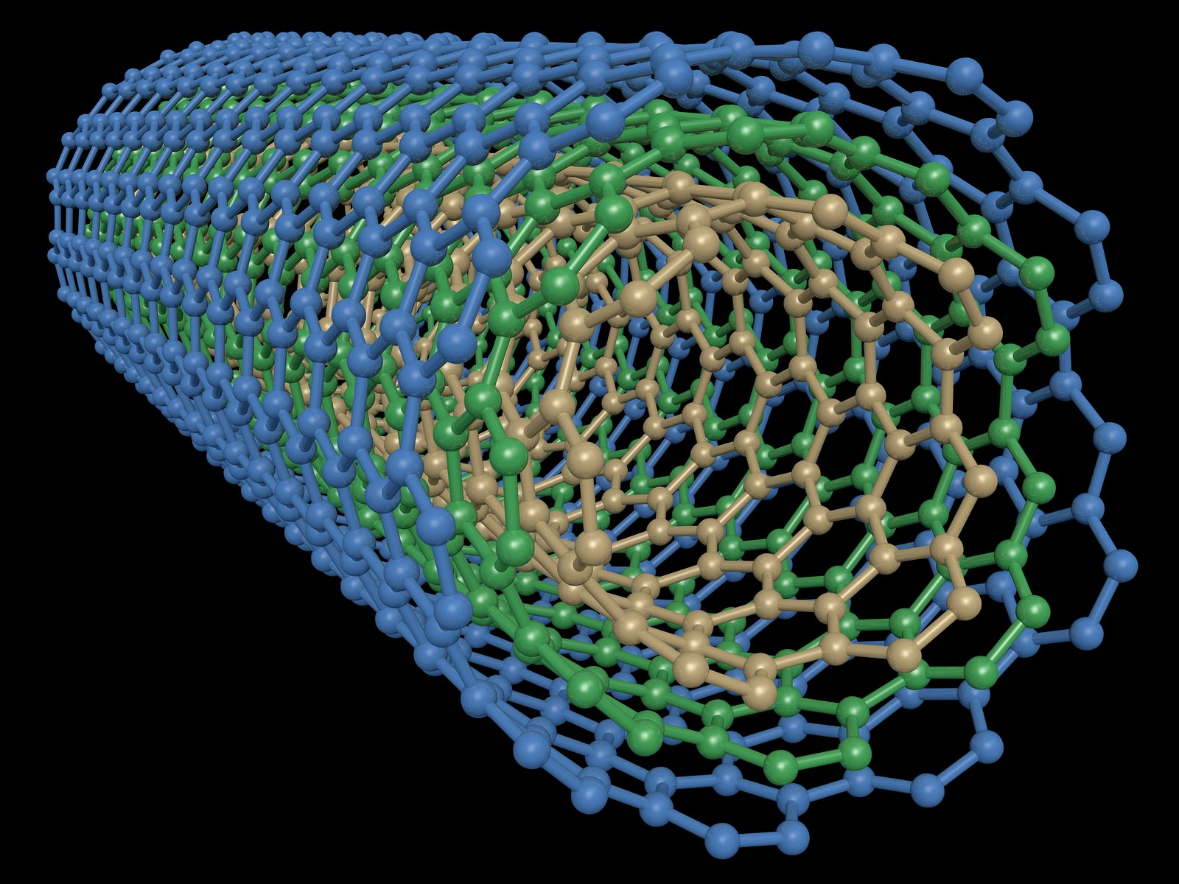
2015 – 2040
GLOBAL MULTIWALLED CARBON NANOTUBES MARKET OVERVIEW
Prepared for :
MARKET INTELLIGENCE . CONSULTING
www.techsciresearch.com

Slide 21

Key Insights : Global Multiwalled Carbon Nanotubes Market
Global Multiwalled Carbon Nanotubes Demand, By Volume, 2015, 2020, 2021E and 2040F (Tonnes)
The demand & production of the Multiwalled Carbon Nanotubes is anticipated to grow due to boosting demand in Electronic and Electrical Industry for semiconductors and in Plastics and Composites Industry to enhance electrical and mechanical properties of the products.
On the global level, the top operating players in the Multiwalled Carbon Nanotubes market is Chengdu Organic Chemistry Co., CNano Technology Limited, LG Chem, Nanocyl S.A., Showa Denko K.K. and Arkema Inc. These top five operating players have a manufacturing capacity of more than 400 tonnes and usually serve the industrial applications. There are a huge number of manufacturing facilities that have the capability to manufacture MWCNT for research purposes in small quantities.
The global market of the Multiwalled Carbon Nanotubes will be dominated by Plastics and Composite Industry followed by Electrical and Electronics Industry with a market share of 54.12% and 27.76% in 2021. Based on the properties required in the end product, the concentration of MWCNT is varied.
The Cost Competitiveness is also expected to increase in the market due to increasing with the rising focus of the industry players on providing research and development of the product to provide effective and unique solutions for different applications.
Global Multiwalled Carbon Nanotubes Market Share, By Manufacturing Process, By Volume, 2021E

Slide 22
Recommendations for HPCL Research & Development Team
Multiwalled Carbon Nanotubes Production Methods
High Pressure Carbon Monoxide Reaction (HiPco) Method: In this method, the catalyst is introduced in the gas phase. The hydrocarbon gas and the catalyst are fed into a furnace in gas phase that is followed by catalytic reaction. This method is mostly preferred for large scale synthesis of nanotubes. In most cases, hot carbon monoxide which when reacted with iron pentacarbonyl, Fe(CO)5, forms Multi-wall carbon nanotubes (Multiwalled Carbon Nanotubes).
Catalytic Chemical Vapor Deposition (CCVD) is the most popular manufacturing process of Multiwalled Carbon Nanotubes followed by Chemical Vapor Deposition (CVD). These two processes are similar with small variation in the manufacturing process. CCVD requires catalyst that helps in reducing the temperature of the manufacturing process and provides higher selectivity of the product. CCVD is also simpler than CVD and thus is preferred mode of manufacturing globally.
Raw Materials Used | Carbon Monoxide, Iron Carbonyl, Graphite
Chemical Vapor Deposition (CVD) Method: It is a chemical process used for producing solid materials with high quality and high-performance. The wafer or substrate is exposed to the volatile precursors. It reacts and decomposes the substrate surface to produce the desired deposit. In this method, coal gas is fed into a horizontal quartz reactor that has two stage furnace. The production rate of Multiwalled Carbon Nanotubes increases with the coal gas flow rate. CNTs filled with iron carbide-oxide are produced from CVD by using coal gas at 950oC with ferrocene as a catalyst.
Case | Research Multiwalled Carbon Nanotubes | Industrial Multiwalled Carbon Nanotubes
Scale of Production | Low | High
Reactor Type | Fixed Bed | Fluidized Bed
Type of Operation | Batch | Continuous
Yield (m/m) | ~ 50 | ~ 200
Growth Time (h) | 2 | 0.5
Raw Materials Used | Carbon Monoxide, Graphite, Hydrocarbon Feedstock (Methane, Acetylene etc.)

Slide 23
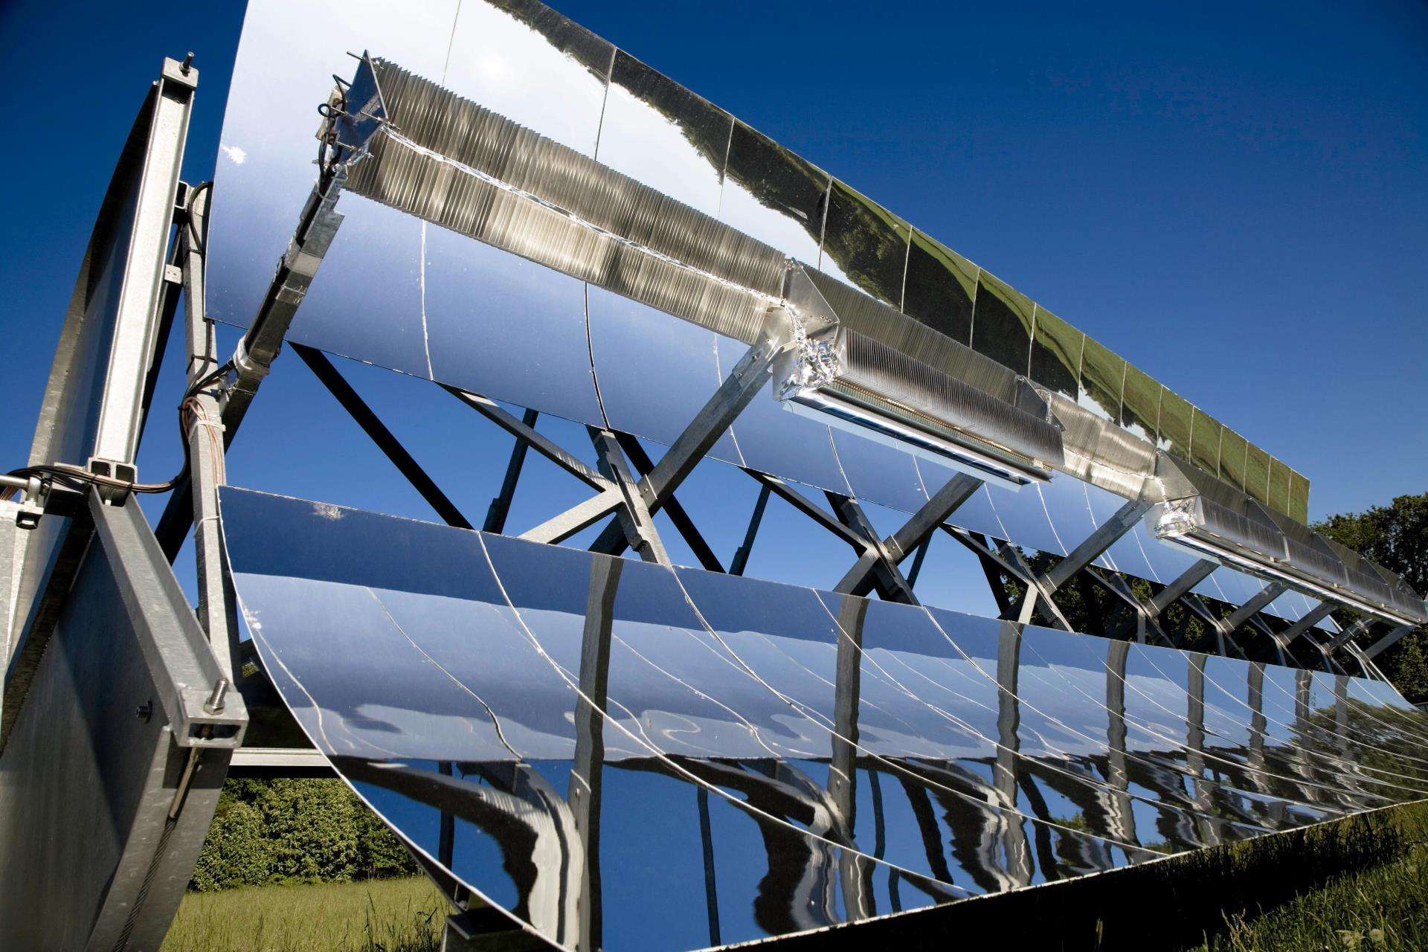
2015 – 2040
GLOBAL HIGH TEMPERATURE MOLTEN SALTS FOR HEAT EXCHANGE APPLICATIONS MARKET OVERVIEW
Prepared for :
MARKET INTELLIGENCE . CONSULTING
www.techsciresearch.com

Slide 24

Key Insights : Global High Temperature Molten Salts Market
Global High Temperature Molten Salts Demand, By Volume, 2015, 2020, 2021E and 2040F (Thousand Tonnes)
The demand is anticipated to increase at a CAGR of 3.38% and reach 7.4 million tonnes by 2040 due to rising number of set up of solar power plants globally to save non-renewable sources of energy and generate energy in cost effective and energy efficient manner.
Global High Temperature Molten Salts Demand, By Application, 2020, 2021E and 2040F
Return of Investments are also high due rising awareness about the solar energy usage and increasing number of solar power plants that use molten salts based thermal energy storage systems.
Europe is the major consumer of High Temperature Molten Salts followed by America and Africa. These regions have higher number of solar power plants that are based on molten salts.
Global High Temperature Molten Salts Market Share, By Region, By Volume, 2021E
HPCL should invest in setting up a production unit for High Temperature Molten Salts

Slide 25
Recommendations for HPCL Research & Development Team
Selected High Temperature Molten Salts Specifications for Industrial Application
Molten Salts | NaNO₃-KNO₃ | LiF-NaF-KF | Li₂CO₃-Na₂CO₃-K₂CO₃ | NaCl-KCl-ZnCl₂
Composition by wt% | 60 : 40 | 29.3 : 11.7 : 59 | 32.1 : 33.4 : 34.5 | 8.1 : 31.3: 60.6
Melting Point (°C) | 220 | 454 | 400 | 229
Thermal Stability (°C) | 600 | 850 | 715 | 850
Density (Kg/cm³) | 1708-1950 | 1851-2116 | 1960-2070 | 1946-2275
Heat Capacity (KJ/Kg) | 1.48-1.55 | 1.28-1.82 | 1.61 | 0.90-0.92
Viscosity | 0.99-5.78 | 1.64-12.38 | 6.11-45.09 | 3.48-29.63
Thermal Conductivity | 0.33-0.40 | 0.05-0.27 | 0.45-0.49 | 0.30-0.38
Material Cost (USD/Kg) | 0.5-0.8/Kg | >2 | 1,3-2.5 | <1
Currently, there are no manufacturers of high temperature molten salts in India and thus, the dependence of the chemical companies and thermal energy storage systems relies on European and Chinese companies.
Operation with molten salt systems as heat transfer is more delicate on changing weather conditions. Operational and maintenance cost reduction as no special maintenance activities on salt system, Some plants in Europe registered 15 to 20% higher annual performance compared to expected values.
There are various types of high temperature molten salts that are manufactured depending on the properties required by the customer. They can be binary or ternary salts depending on the composition of the salt. KNO₃, NaNO₃, NaNO₂ are the most used salts for binary and ternary salt mixtures that can be obtained naturally and artificially.
Commercial factors that are expected to affect the market of High temperature Molten Salts is the changing scenario of the market and the rising demand to use renewable sources of energy.

Slide 26

2015 – 2040
APAC JP-10 MARKET
FORECAST & OPPORTUNITIES
Prepared for :
MARKET INTELLIGENCE . CONSULTING
www.techsciresearch.com

Slide 27

Key Insights : APAC JP-10 Market
Global Jet Fuel Military Grade (JP-4, JP-5, JP-8, JP-10) Market Size, By Value, 2015, 2020, 2021E and 2040F (USD Billion)
Global JP-10 Market Size, By Value, 2015, 2020, 2021E, and 2040F (USD Million)
US JP-10 Pricing Analysis, 2015, 2020, 2021E, 2040F(USD Per Gallon)
Currently, JP-10 is used in the defense sector as a fuel for missiles. Increase in the missile numbers till the forecasted period will increase the market from the demand side. Various pilot projects on Bio-based JP-10 is said to reduce the cost limitation associated with it to use in commercial aviation. Majority of the JP-10 fuel is currently used in US. However, Research & Development of various emerging countries of APAC and Europe are monitoring and developing a product for their market.
there is a need to develop high density JP-10 fuel in the country. The most important requirement of the missile fuel is to put more available energy in each unit of volume. Country like Japan, America, China etc. are manufacturing for their missile systems.
The price for JP-10 fuel is expected to reduce for the forecasted period. Many research and development activities are identifying route to manufacture JP-10 fuel from bio route. Increased availability of the product will result in consistent decline of price during forecast period.

Slide 28
Recommendations for HPCL Research & Development Team
PRODUCTION PROCESS OF JP-10
Majority of Jet fuel used in Military application are JP-4, JP-5, JP-8 and JP-10. The composition of these fuels are very similar. Predominantly consists of C9–C16 hydrocarbons that are a combination of n-paraffins, isoparaffins, naphthenes, and aromatics. Rapid Economic Development and increasing security threat led to substantial increase in defense resources. Increasing budget in Procurement and R&D activities in global defense will increase the fighter jets in upcoming years.
According to DRDO, most of the propellant engine used in India consists of oxidizer. However, researches are working on developing cost-efficient technologies which can utilize atmospheric oxygen for combustion
Conversion of Dicyclopentadiene to Endo-tetrahydrodicyclopentadiene with catalyst Pd/C
Hydrogenation
Conversion of Endo-tetrahydrodicyclopentadiene to Exo-tetrahydrodicyclopentadiene with Conc. Sulphuric acid
Isomerization
JP-10 is manufactured by processing Dicyclopentadiene from steam cracking of naphtha and gas oils to ethylene.
JP-10 is a single component fuel that consists of 96.5 wt% exo-tetrahydrodicyclopentadiene, 2.5 wt% endo-tetrahydrodicyclopentadiene and 1 wt% adamantane.
Thus, crude oil processing companies do not prefer to manufacture DCPD or exo-DCPD through costly processes.
Key Properties of JP-10
Property | Value
Average formula | C10H16
H/C ratio (mole) | 1.6
Average molecular weight (g/mol) | 136.2
LHV (MJ/kg) | 43
Model formula | C10H16

Slide 29

TechSci Research – North America
708 Third Avenue, Manhattan,
New York, United States
Tel: +1- 646- 360- 1656
Email: sales@techsciresearch.com www.techsciresearch.com
TechSci Research – Europe
54, Oldbrook, Bretton,
Peterborough,
United Kingdom
Email: sales@techsciresearch.com www.techsciresearch.com
TechSci Research – Asia-Pacific
B – 44, Sector – 57, Noida, National Capital Region, U.P. - India
Tel: +91-120-4523900
Email: sales@techsciresearch.com www.techsciresearch.com
Thank you!!
We look forward to serving your research needs!!

